Slide 1
Bridging semantics and syntax with graph algorithms —state-of-the-art of extracting biomedical relations
Yuan Luo,O¨ zlem Uzuner and Peter Szolovits
160728

Slide 2
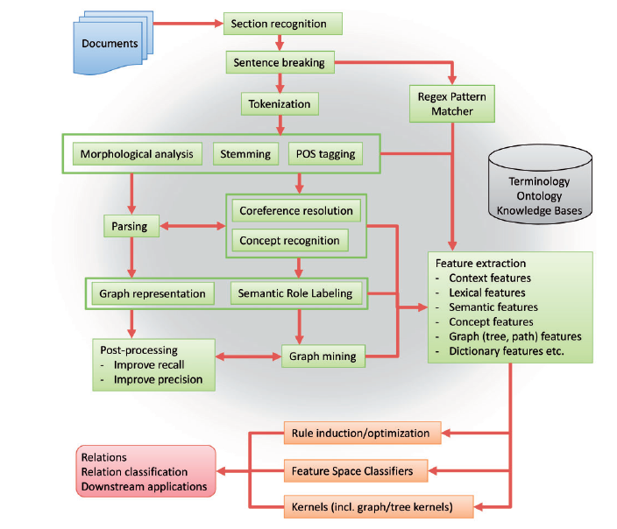
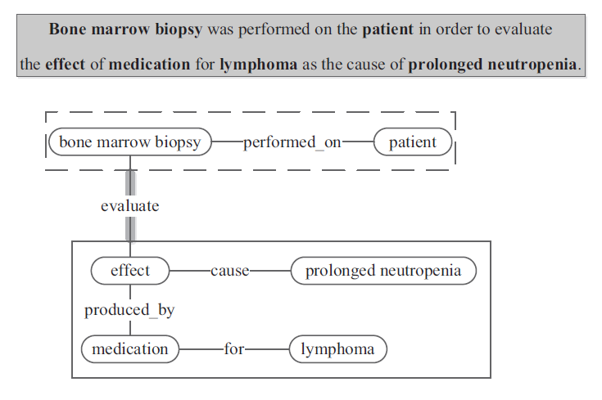
General pipeline for biomedical relation extraction

Slide 3
Introduction to graph representations and graph algorithms for biomedical relation extraction
Graph representation for narrative sentences naturally breaks down to the choice of information represented by nodes and edges.
Common node choices
Tokens
Named entities
Semantically labeled named entity
Relations themselves within nested relations
Common edge choices
Syntactic dependency
Syntactic constituency link
Event argument
Association
Common algorithm category
Some identify shortest path between concept pair
Some create association graph then try to apply customized labels to them
Some use subgraph matching to compare the similarity between subgraphs based on a score that aggregates node distances and edge distances
Some carry out frequent subgraph or subtree pattern mining to directly extract candidate relations
Some directly parse graph representation of relations from sentences by integrating the graph structure into the learning objective of the parsers.

Slide 4
Introduction to graph representations and graph algorithms for biomedical relation extraction
Methodology for biomedical relation extraction has received increasing attention.
Conventional approaches focus on using co-occurrence statistics as a proxy for relatedness
Some clinical NLP systems apply hand-crafted syntactic and semantic rules to extract prespecified semantic relations, but are hard to adapt to new subdomains.
Ex) MedLEE and SemRep
Recent research focuses more on syntactic parsing, to develop generalizable methods to extract relations that fully explore the constituency and dependency structures of natural language.
We organize research work around the challenge they participate or as non-challenge-participating research

Slide 5
Relation extraction from the scientific literature
Continuous effort has been directed to extracting semantic relations from biomedical literature text, often in the form of shared-task community challenges that aim to assess and advance NLP techniques.
Notable community challenges include
BioNLP shared task on event mining
BioCreative shared tasks on PPIextraction
DDIextraction challenges on DDI extraction
Perhaps through learning the lessons from these challenges, real-world applications such as the field of pharmacogenomics also saw significant momentum in development of graph-based text-mining methods.

Slide 6
Relation extraction from the scientific literature - BioNLP event extraction shared tasks
Three BioNLP shared tasks (ST) have focused on recognizing biological events (relations) from the literature.
These tasks provided the protein mentions as input and asked the participating teams to identify a predefined set of semantic relations.
BioNLP-ST-2009 consisted of three tasks, including
core event detection
event argument recognition
negation/speculation detection (all based on the GENIA corpus)
BioNLP-ST-2011 expanded the tasks and resources to cover more text types, event types and subject domains
BioNLP-ST-2011 added the following tasks:
Besides the continued GENIA task (GE),
Epigenetics and post-translational modification (EPI),
infectious diseases (ID)
bacteria biotope (BB)
bacteria interaction (BI).
BioNLP-ST-2013 further expanded the application domains with tasks of
GE, BB, cancer genetics (CG),
pathway curation (PC),
gene regulation ontology (GRO)

Slide 7
Relation extraction from the scientific literature - BioNLP event extraction shared tasks
The typical event extraction workflow can be broken into two general steps.
trigger detection and argument detection.
‘[the patient] was put on [Imatinib regimen]’,
the first step detects the event trigger ‘put’,
the second step detects the theme ‘Imatinib regimen’ and target argument ‘patient’.
Bjorne et al.
Built Turku Event Extraction System (TEES)
converted sentences to a dependency graph using the McClosky-Charniak-Johnson parser and explored the graphs to construct features for both steps.
This method generated n-gram features connecting event arguments based on the shortest path of syntactic dependencies between the arguments.
Hakala et al.
built on top of the TEES system and re-ranked its output by enriched graph-based features, including paths connecting nested events and occurrence of gene–protein pairs in general subgraphs mined from external PubMed abstracts and the PubMed Central full-text corpus.
The strong performance of both systems with heavy utilization of graph-based features, especially the fact that Hakala et al. extended Bjorne et al. using enriched graph-based features and obtained better performance, suggests the potential benefits of exploring graph-based features.

Slide 8
Relation extraction from the scientific literature - BioNLP event extraction shared tasks
Miwa et al.
built the EventMine system that can extract not only biomedical events but also their negations and uncertainty statements.
For event extraction, they used the Enju parser and the GENIA Dependency parser (GDep) to generate path features along with dictionary-based features.
Ex) UMLS Specialist lexicon and Wordnet
Their path features include not only paths between event arguments but also paths between event argument and non-argument named entities.
The latter paths likely account for the strong performance by providing more local context features.

Slide 9
Relation extraction from the scientific literature - BioNLP event extraction shared tasks
Another vein of work proposed joint event extraction in which triggers and arguments for all events in the same sentence are predicted simultaneously
McClosky et al.
integrated event extraction into the overall dependency parsing objective
McClosky-Charniak-Johnson parser and converted the parses to Stanford Dependency.
the annotated event structures in the training data -> event dependency graphs.
the event dependency graphs -> Stanford Dependency graphs
generated graph-based features to train an extended MSTParser for extracting event dependency graphs from test data.
graph-based features : paths between nodes, subgraphs consisting of parents, children and siblings of the path nodes in the Stanford Dependency graph.
They then converted the top-n extracted event dependency graphs -> event structures
re-ranked event structures for the best one, using the same graph-based features from event dependency graphs
Riedel et al.
scored candidate graphs using a function that captures constraints on event triggers and arguments.
The scoring function considers token features, dictionary features and dependency path features.
Riedel et al. further used a stacking model to combine their system with the system by McClosky et al.

Slide 10
Relation extraction from the scientific literature - BioNLP event extraction shared tasks
Most of the remaining BioNLP systems also used graph-based features to various extents.
Liu et al.
developed an Exact Subgraph Matching (ESM) method, and later a more flexible Approximate Subgraph Matching (ASM) method
processed sentences with the McClosky-Charniak-Johnson parser
transformed the parses to directed dependency graphs
constructed the graph of an event by computing unions of dependency paths between event arguments
Then applied ESM/ASM from sentence graphs to event graphs, using a customized distance metric that accounts for subgraph differences in graph structure, node-covered stemmed words and edge directionality.
extended their method by integrating Protein Data Bank (PDB) , Uniprot and Biothesaurus to recognize protein/residue names also adapted their method to other corporaincluding BioInfer and Uniprot corpus
This work falls along the lines of graph kernel-based methods.
But this kernel methods usually cannot directly weight/rank features.
Kilicoglu et al.
adopted the McClosky-Charniak-Johnson Parser/Stanford Dependency pipeline.
They converted the dependency graphs to embedding graphs to apply post-processing rules to traverse embedding graphs and extract nested events.
However, their embedding graphs also lead to argument error propagation and hurt precision.

Slide 11
Relation extraction from the scientific literature - BioNLP event extraction shared tasks
Besides the popular McClosky-Charniak-Johnson Parser/Stanford Dependency pipeline, some systems experimented with different parsers and/or dependency representations.
Hakenberg et al.
applied BioLG, a Link Grammar Parser extension, to generate parse trees
stored parse trees in a database
designed a query language to match subgraph patterns
Van Landeghem et al.
analyzed dependency graphs from the Stanford Parser, identified minimal event-containing subgraph patterns from training data and constructed extraction rules based on these patterns.
Their post-processing rules handled overlapping triggers of different event types and events based on the same trigger, trading recall for precision.

Slide 12
Relation extraction from the scientific literature - BioNLP event extraction shared tasks
The other systems generally used the dependency paths connecting the concept pairs as features for event extraction.
For example
The Pro3Gres parser (Kaljurand et al.)
The RASP parser (Vlachos et al)
Both McClosky-Charniak-Johnson parser and Enju parser
However, most of these methods attained inferior performance compared with the best systems in the same tasks.
We believe that there are at least two reasons:
The McClosky-Charniak-Johnson parser with the self-trained biomedical parsing model is probably the most accurate parser in this domain.
The enriched graph-based features and event type generalization as used by the best systems likely produced more useful features for event extraction.

Slide 13
Relation extraction from the scientific literature - PPI extraction and BioCreative shared tasks
BioCreative shared tasks focused on automatic named entity recognition on genes and proteins in biomedical text and on extraction of the interactions between these entities
Most systems used
co-occurrence statistics
pattern templates
shallow linguistic features (e.g. context words and part-of-speech tags)
with either statistical machine learning or rule-based systems.
Huang et al.
developed a profile-based method that creates a vector representation for candidate protein pairs by aggregating features from multiple sentences in the document.
The profile features included n-grams, manually constructed templates and relative positions of protein mentions

Slide 14
Relation extraction from the scientific literature - PPI extraction and BioCreative shared tasks
In BioCreative-II.5, based on the top teams in the PPI task, the organizers pointed out that the BioNLP techniques using deep parsing and dependency tree/graph mining were necessary to achieve significant results.
Hakenberg et al.
used a system similar to their BioNLP-ST-2009 entry system.
They manually generated subgraph patterns from training data and matched them against parse trees.
Their f-measure was 0.30.
Sætre et al.
applied the Enju parser and the GDep parser and considered the dependency paths between concept pairs as features for relation extraction
They achieved an f-measure of 0.374.

Slide 15
Relation extraction from the scientific literature - PPI extraction and BioCreative shared tasks
The PPI tasks of BioCreative-III consisted of detecting PPI-related articles that provide evidence to specified PPIs, but did not include the actual extraction of PPIs.
Several follow-up studies to BioCreative-II.5 evaluated the usage of kernels in PPI extraction
(1) shallow linguistic (SL) kernels;
(2) constituent parse tree-based kernels
including subtree (ST), subset tree (SST) and partial tree (PT) kernels that use increasingly generalized forms of subtrees, as well as a spectrum tree (SpT) kernel that uses path structures from constituent parse trees;
(3) dependency parse tree-based kernels
including edit distance and cosine similarity kernels that are based on shortest paths k-band shortest path spectrum (kBSPS) that additionally allows k-band extension of shortest paths, all-path graph (APG) kernel that differently weights shortest paths and extension paths in similarity calculation, as well as Kim’s kernels that combine lexical, part-of-speech and syntactic information along with the shortest path structures.

Slide 16
Relation extraction from the scientific literature - PPI extraction and BioCreative shared tasks
The comparative studies and error analyses showed that:
(1) dependency tree-based kernels generally outperform constituent tree-based kernels;
(2) kernel method performances heavily depend on corpus-specific parameter optimization;
(3) APG, kBSPS and SL are top-performing kernels;
(4) ensembles based on dissimilar kernels can significantly improve performance;
(5) non-kernel-based methods (e.g. rule-based method, BayesNet) can perform on par with or better than all non-top kernel methods.
From these observations, it is evident that richer dependency graph/tree structures than shortest paths are important to better performance of graph/tree-based kernels

Slide 17
Relation extraction from the scientific literature - DDI extraction and DDIExtraction shared tasks
The two DDIExtraction challenges (2011 and 2013) aimed at automated extraction of DDI from biomedical text.
The organizers of the two challenges recognized the extended delays in updating manually curated DDI databases.
They observed that the medical literature and technical reports are the most effective sources for the detection of DDIs but contain an overwhelming amount of data.
DDIExtraction-2011 focused on classifying whether there is any interaction between candidate drug pairs.
DDIExtraction-2013 additionally pursued detailed classification of DDIs into one of the four possible subtypes
advice , effect, mechanism and int

Slide 18
Relation extraction from the scientific literature - DDI extraction and DDIExtraction shared tasks
In DDIExtraction-2011,
Thomas et al.
applied the McClosky-Charniak-Johnson parser/Stanford dependency pipeline.
They used voting to combine the following kernels to implicitly capture features for relation extraction:
APG , kBSPS and SL kernels.
Their system achieved the best f-measure of 0.657.
Chowdhury et al.
applied the Stanford parser to obtain dependency trees and experimented with both feature-based methods and kernel-based ensemble methods for relation extraction.
They experimented with SL , mildly extended dependency tree (expanding shortestpaths to also cover important verbs, modifiers or subjects) and path-encoded tree kernels.
By combining feature-based and kernel-based methods, Chowdhury et al. achieved the second best f-measure of 0.6398.

Slide 19
Relation extraction from the scientific literature - DDI extraction and DDIExtraction shared tasks
In DDIExtraction-2013,
Thomas et al.
followed a two-step approach
first detect general DDIs and then classify detected DDIs into subtypes.
For the general DDI task, they used voting to combine kernels including APG, subtree (ST), SST, SpT and SL kernels.
For the subtype classification step, they used TEES directly.
Their system performed second best with an f-measure of 0.76 for general classification and 0.609 in detailed classification
Chowdhury et al.
used their previous kernel method but switched to the McClosky-Charniak-Johnson parser and converted the parses to Stanford Dependency
They attained an f-measure of 0.80 for general classification and 0.65 for detailed classification and placed first.
It is interesting to see that adoption of systems originally developed for PPI extraction or event extraction has led to top performances in DDIExtraction.
This further corroborates that these tasks are closely related, and technical solutions for one are generalizable to others.

Slide 20
Relation extraction from the scientific literature - Pharmacogenomics
numerous efforts have centered on the utilization of literature and clinical text to mine interesting relations between genetic mutations and drug response phenotypes.
Although it is difficult to compare their performances.
because the experiments are not on shared corpora.
these approaches do illuminate the translational application and adaptation of some state-of-the-art biomedical relation extraction techniques to problems directly asked by clinicians and pharmacologists.

Slide 21
Relation extraction from the scientific literature - Pharmacogenomics
Some systems used path-based approaches.
Coulet et al.
aimed at extracting binary relations between genes, drugs and phenotypes to build semantic networks for pharmacogenomics.
They first converted the Stanford Parser output on sentences (from collected PubMed abstracts) into dependency graphs.
They tracked the paths starting from named entities and ending at a verb, and merged paths ending with the same verb to form binary relations. Coulet et al. retained frequent relations and normalized both the collected entities and relation types (verbs). Without requiring prior enumeration of relation types, they created a semantic network knowledge base from 17 million MEDLINE abstracts, providing semantically rich summaries of pharmacogenomics relations
Percha et al.
Extended this approach to use breadth-first search to yield the shortest path between two named entities in the dependency graph to generate features for relation extraction. They combined the extracted gene–drug relations to infer DDIs for those drugs that interact with the same gene product.
Wang et al.
Used Latent Dirichl et al. location to create a semantic representation of biomedical named entities and used Kullback-Leibler (KL) divergence to calculate the association distance between pairs of entities in the Chem2Bio2RDF [149] semantic network.
They ranked candidate associations between named entity pairs by summing distances along the path connecting the pairs.
They demonstrated uses cases on novel knowledge discovery including searching and predicting novel gene–drug associations, traversing the mined semantic network to compare the molecular therapeutic and toxicological profiles of candidate drugs.

